Slide 1


Machine Learning Hackathon IITG
Team Members
Anuj Singhal
Rahul Deo Burman
Abhinav Meesala
Nidhi E. Gupta
Ankit Upadhayay
Priya Yadav
Samant Sagar
Pankaj Sharma

Slide 2


Business Problem
You are a data scientist at Megakkart the largest ecommerce platform in the country.
Owing to the festive season Megakkart is planning a ‘Super Festive Sale’ where it wants to achieve a GMV sales of INR 500 crores.
You are being provided with the user data for the past one year on various parameters mentioned below. You need to identify whether the user on the web portal will make a purchase or not.
The company plans to work on various hooks for the customers who are at a risk of not making a purchase. Your analysis and machine learning model will help the product team to plan these hooks.

Slide 3

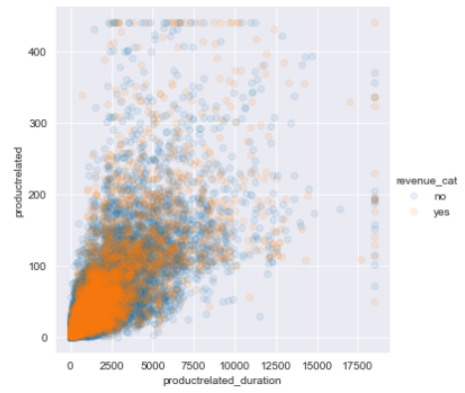
Recommendations
Improve Product Related Pages
Product Related Pages are the where your visitors are!
Visitors are spending a significant time at Product related pages but Not making a Purchase
Understand why they are spending So much time here?
Are they not finding what they are looking for easily?
Are you not matching Customer expectations?
Are they pages not accessible via different devices or operating systems?
Are they difficult to Navigate?
Recommendations:
A/B testing for Product related pages to understand Expectations and Preferences on Navigability ( To make users find information they are looking for faster)
Make sure the Information provided in product pages is Clear and Concise
The Buying process is complex (Not many purchasing options, No support for any queries they have (Chat Bots, Customer Service)

Slide 4

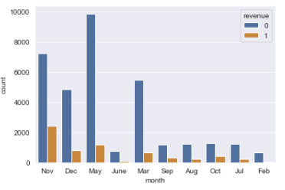
Recommendations
Focus on Seasonal “Special” purchases
November, December, May and March are the months we have the maximum Visitors
Special days are when your customers are purchasing the Most!!
Provide Combo Products and Offers:
Offer discounts on additional Purchases
Bundle a set of best selling items
Use seasonal themes in your Outgoing marketing campaign

Slide 5
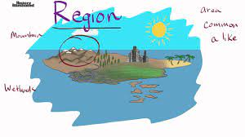
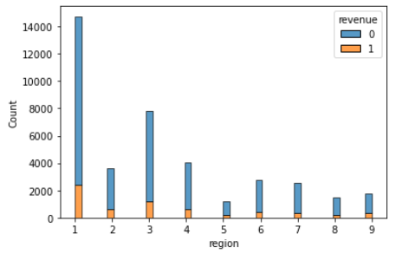
Recommendations
Focus on majorly accessed region by visitor
Region 1 and 3 are the mostly accessed by maximum Visitors
This Region can be Asia, Middle east, America or Europe
Understand why visitors approach the site and leave without generating revenue?
Are products are not matching their region?
Are customer expectations is different?
Are there different types of customers that exist in this region?
Provide Promotions, Advertisements, and Offers:
More network traffic, so that customers can access pages faster and generate revenue
More discounts coupons specifically for that region

Slide 6

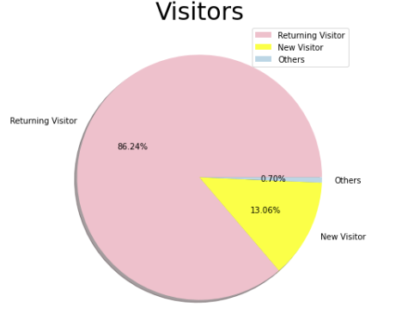
Recommendations
Focus on visitors types
Returning Visitors are 86%, so more focus on existing ones by giving more discounts.
Attract New Visitors by Promotions, Discounts etc. !!

Slide 7
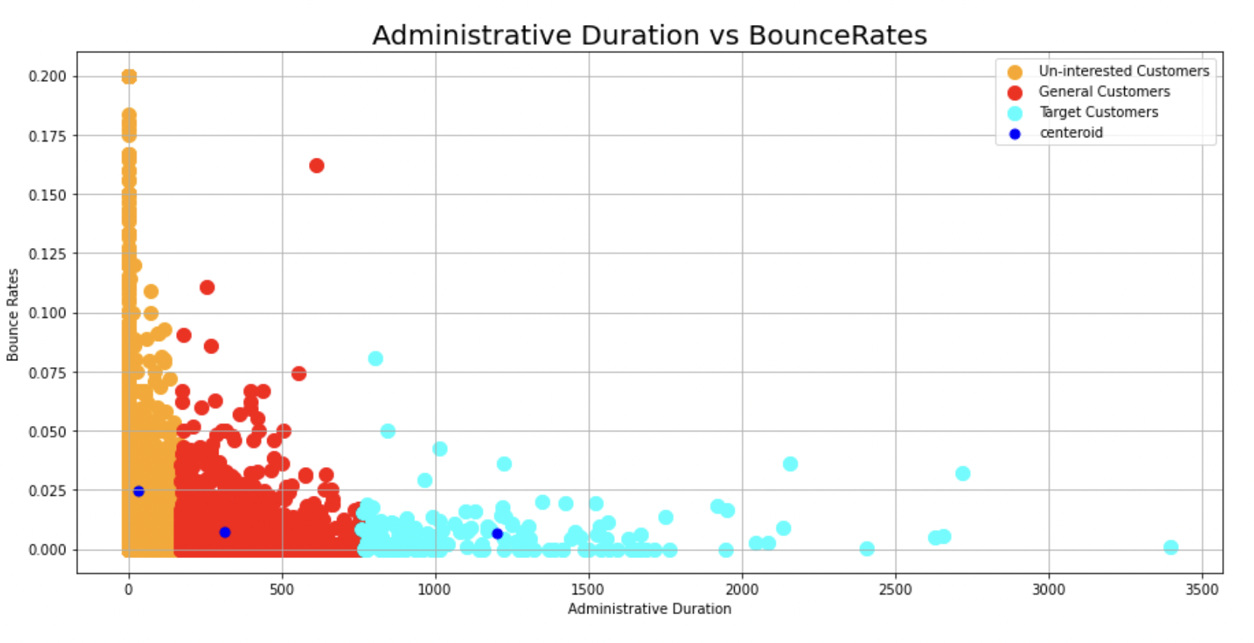
Recommendations
Focus on Administrative Duration
The customers who spent a longer administrative duration in a website are very less likely to bounce from the website that is nevigating away from the website just after navigating one page of that website.
There are Three groups, The Orange group is a group of customers who stay for shortest administrative duration and have highest chance for Navigating away from a website.

